Slide 1
Spatiotemporal Remote Sensing, automated in-situ IoT sensors & ML to monitor and predict HABs and cyanotoxins. Case Study-Lake Victoria
Presenter:
Name: OKELLO, JACOB OKOMO
Reg. No: ENC222-0149/2017

Slide 2
Introduction
Topic is about
Support the Title
Why there’s need for this research
What have other researchers said about this issue?
What has been done to solve this problem?

Slide 3
Introduction
Move 1 establish your territory (say what the topic is about)
Move 2 establish a niche (show why there needs to be further research on your topic)
Move 3 introduce the current research (make hypotheses; state the research questions)
Start globally > regionally > nationally > locally outline the issue at hand.
What have other researchers said about this issue?
What has been done to solve this problem?

Slide 4
Problem statement
By now you’ve identified gaps in the past studies
Clearly outline it here
After reviewing the papers and gaps – what exactly is the problem? state this explicitly.
Ensure you mention the problem, area, and in detail the problem specifics

Slide 5
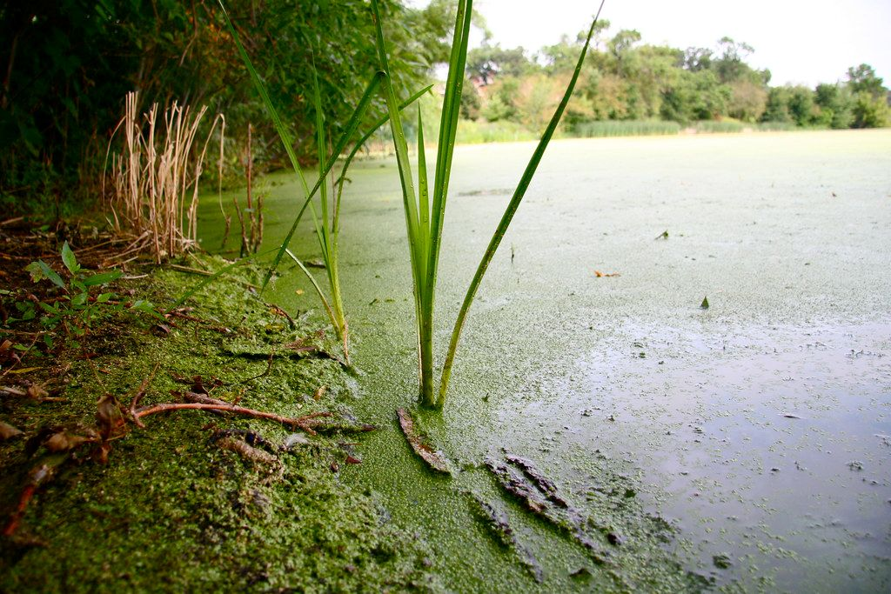
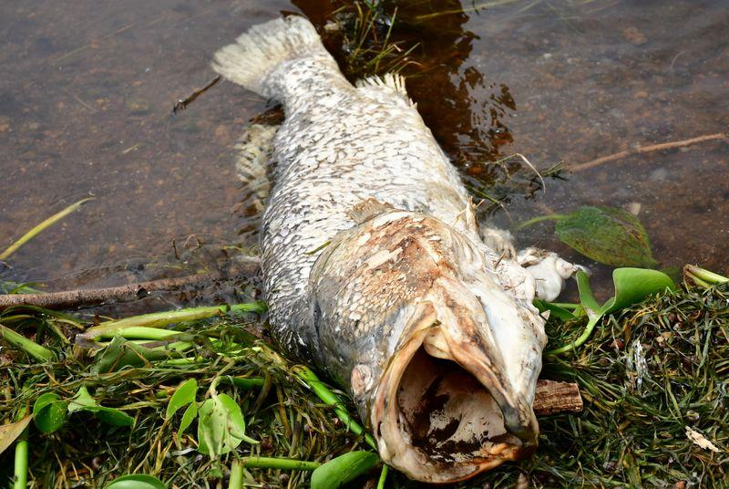
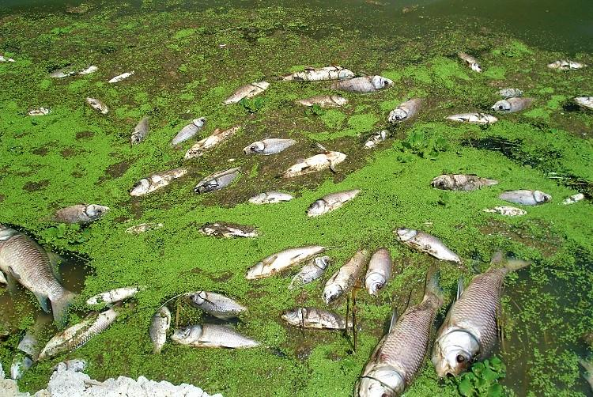
Justification

Slide 6
General and specific objectives
To monitor and predict the occurrence of Harmful Algal Blooms(HABs) and Cyanobacteria.
To develop automated in-situ Internet of Things(IoT) sensors to monitor the occurrence of the event.
To develop a system that reports specified geo-tagged data from the above sensors.
To associate Machine Learning models to predict the occurrence of CynoHAB.

Slide 7
Overall Methodology : Data and Materials
Data & Materials;
Data Type | Source | Access
Shapefiles | Database of Global Administrative Areas- GADM | Free
MODIS Aqua | Google Earth Engine Cloud Repo | Free
Landsat 8 OLI | Google Earth Engine Cloud Repo | Free
In-Situ & Meteorology Data | Lake Victoria Water Quality Mgt My Automated In-situ System | -Uncertain -Within my control
Tool/ Material | Role | Availability
Google Earth Engine | Geocomputation & Processing | Freely Available
QGIS, R & Python | Further Analysis, Maps & Prediction | Free
Microcontroller, Sensors & Gateway | In-situ data collection & Monitoring | Local Purchase

Slide 8
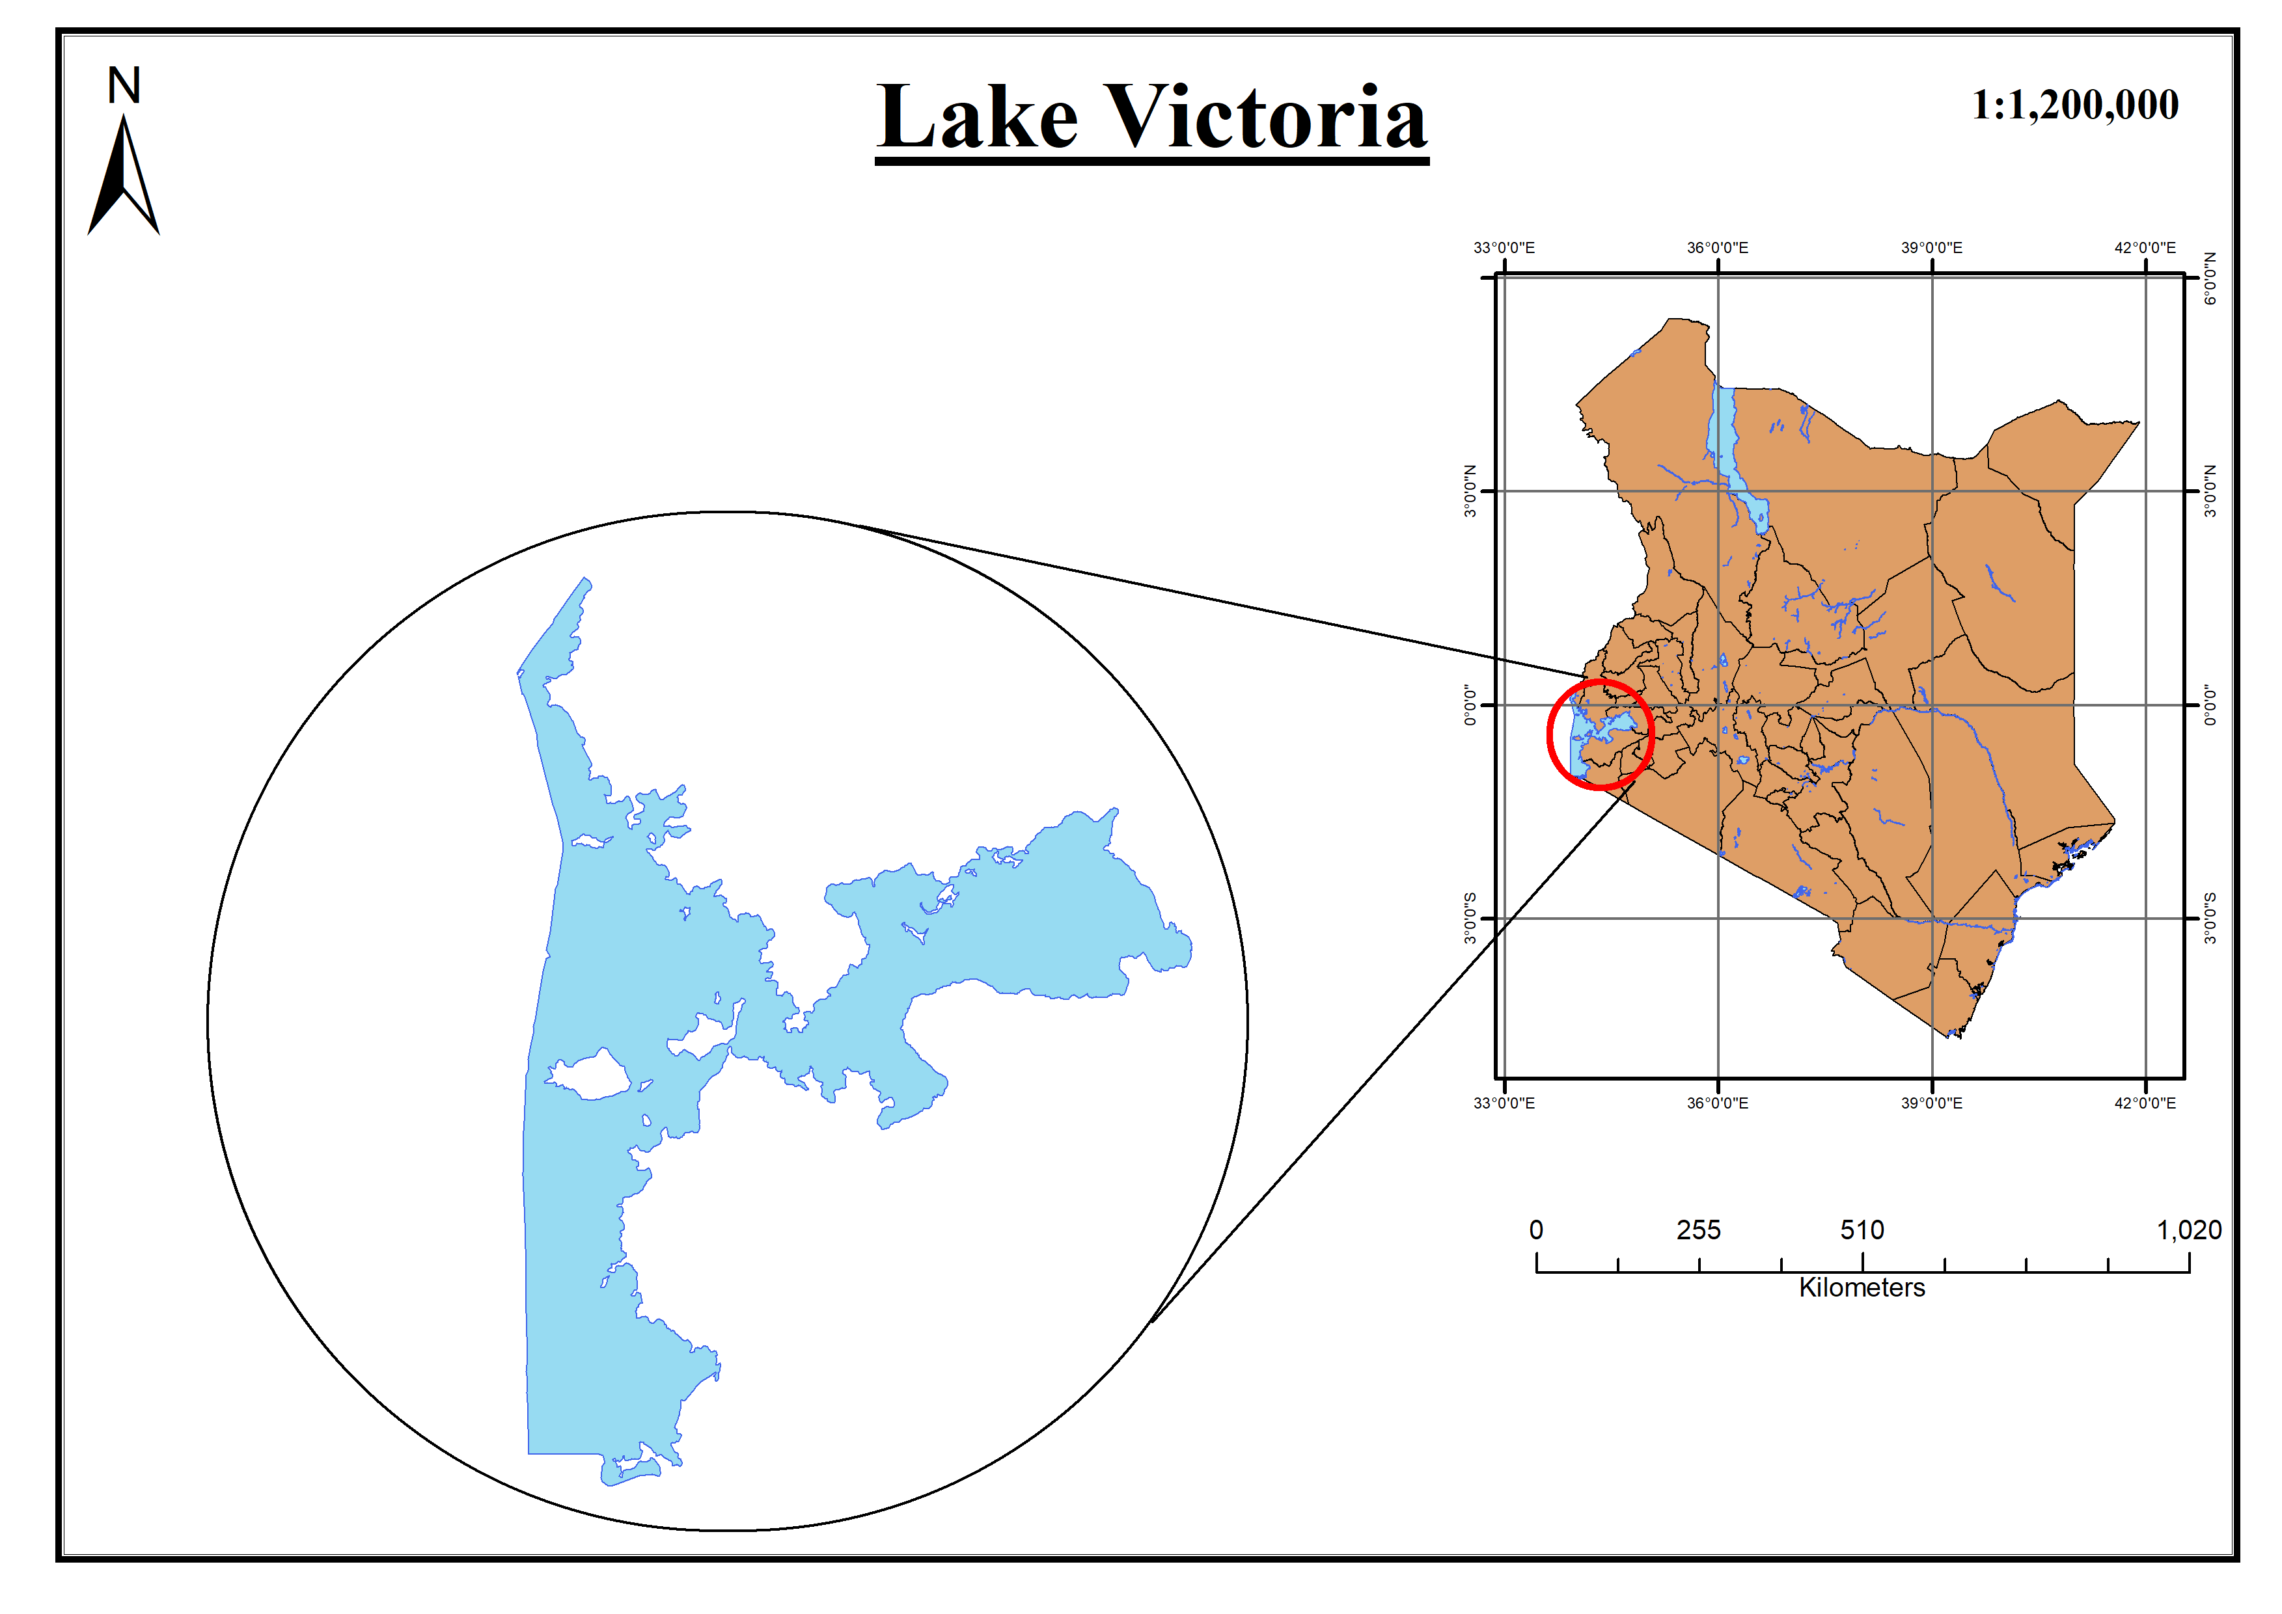
Study Area

Slide 9
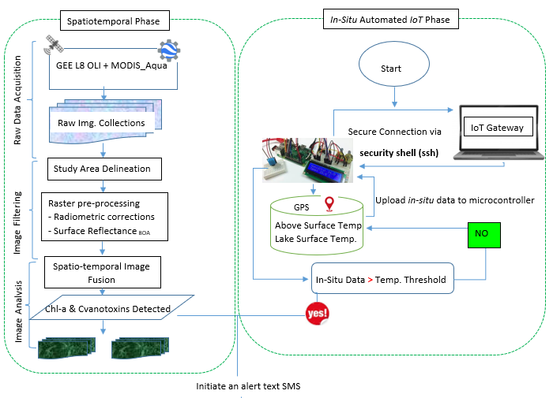
Overall methodology

Slide 10
Expected Results
Chlorophyl-a Geographical Maps associating the occurrence of the Harmful Algal Blooms and Cyanobacteria.
Automated system that monitors and reports geo-tagged data
Reported confirmation alert Text SMS reporting in near-real time the in-situ status from the sensors.
Time Series predictive model on any looming bloom.

Slide 11
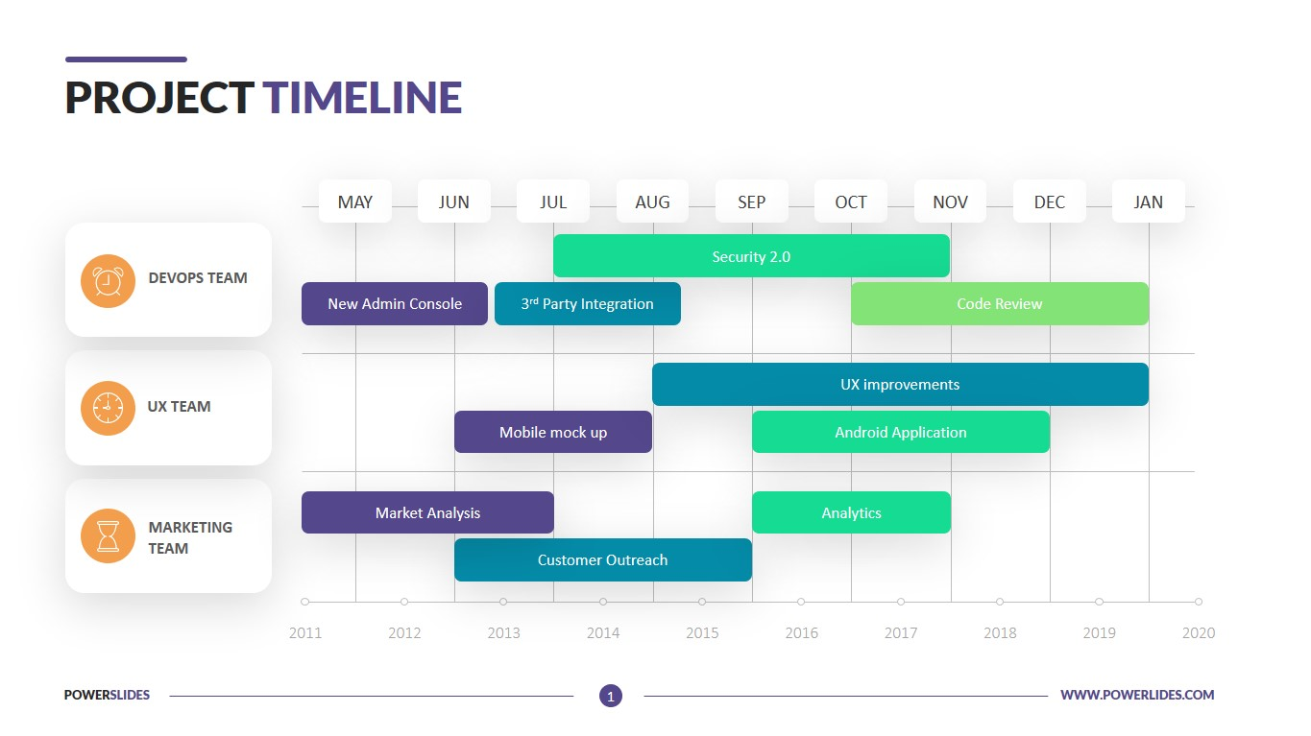
Project Timeline

Slide 12

Thank you for your attention! Questions?

